Slide 1
Quin For CPM Affine Initiative

Slide 2
CONTENTS
01
Quin for MIDB
Pg. No 03
02
User Story Flow Overview
Pg. No 04
03
Solution Architecture
Pg. No 05
04
Quin Tech Architecture
Pg. No 06
05
Additional Capabilities
Pg. No 07
06
Limitations
Pg. No 08
07
Next Steps
Pg. No 09

Slide 3




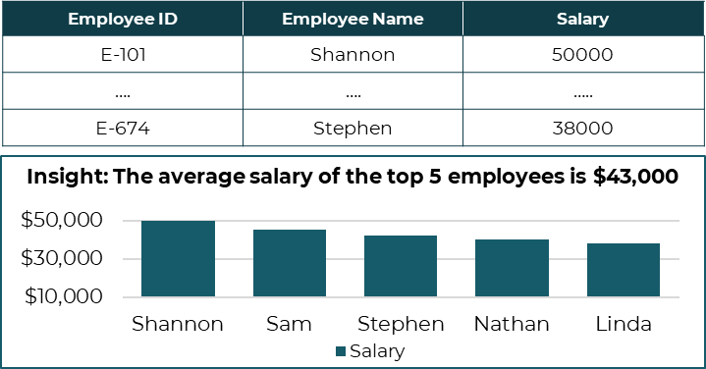




Quin for MIDB
BUSINESS PROBLEM
CAPABILITY USED
Industry
GAMING
Function
PRODUCT MANAGEMENT
To improve accessibility and ease of use of CPM’s MIDB gaming market intelligence tool, an AI solution is needed which can generate insights using conversational language instead of SQL queries
A custom analytics tool, built on Streamlit web interface, processes MIDB like sample data using an AI-driven multi agent systems.
Data Used
MIDB (Market Intelligence DB)
OUTPUT
BUSINESS BENEFITS
Tech Stack
Based on the user questions, relevant data along with insights and visualizations are generated.
Empowering all users, including those without technical expertise, with easy access data & insights
Summarization of complex data and answers to user queries with a click
SQLite Database
GPT 4

Slide 4


User Story Flow Overview
USER INTERFACE
AI ENGINE
DATABASE
Query: What is the Total revenue by Region in 2024?
Schema
NL Query
Prompt Builder
OpenAI GPT 4
Catalogue
SQL: SELECT Region, SUM(Total_Revenue) AS Total_Revenue_2024 FROM midb_table
WHERE strftime('%Y’, Processing_Date_Month) = '2024’ GROUP BY Region
SQL Query
Data Records
Execute query
Input (examples./ sample queries
Fetch Data
OUTPUT
Illustrative
Region | Total Revenue
Rest of the World | 75,776,390,246
North America | 142,604,108,307
Europe | 117,693,149,474
QUERY
VALIDATION
AND
EXECUTION
NLP TO SQL
TRAINER MODULE
Temperature
Instructions
Insight: The total revenue for North America in 2024 is 142.60b
Prompt
Frequency

Slide 5









Solution Architecture
UI Layer
AI Engine
Storage
Data Upload
Data Processing
Planner
Agent 1
Query Validator Tools
SQL query generator
SQL query critic
3 iter - max
Descriptions taken from Data Dictionary
Agent 2
Agent 3
If approved by critic
SQL query executor
SQLite Database
Agent 4
Landing Page
(Chat Window +
History Window)
Insights
Insights generator
Terminator
Queries, Interactions, Results, Feedback, Metadata Stored
Agent 5
Agent 6
User Feedback
Multi – Agent Workflow

Slide 6

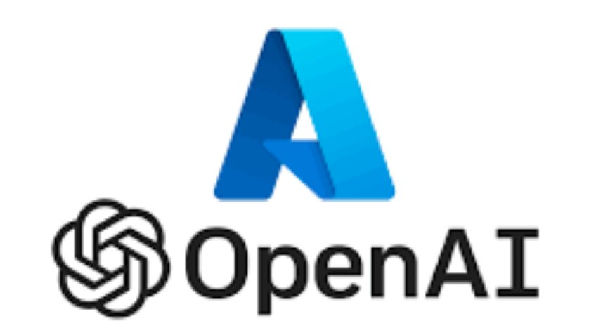





Quin Tech Architecture
Illustration
Required Architecture
Data Storage
LLM API
Data Query Layer
Chatbot UI
Hosting / Deployment
Current Demo Tech Stack
Python SDK
Proposed Tech Stack
Python SDK

Slide 7







Additional Capabilities
ASPECT
VANILLA QUIN (Demo Version)
AGENTIC FLOW (Current Version)
Workflow
Custom Function and GPT based workflow for generating SQL queries and insights
Multi-agent-based sequential framework for efficient and automated query and insights generation
SQL Query Validation
Manual validation of SQL queries using a query editor in target SQL Database
Agent-based syntax validation through function calls, supporting compatibility checks across databases like Oracle, MySQL, and SQL Server
Visualization
Basic visualizations using standard libraries like Matplotlib and Seaborn
Enhanced visualization experience with interactive tools like Plotly
Consistency & Accuracy
Lower consistency and accuracy
Improved consistency and higher accuracy
User Validation
Depends on end-user validation, requiring technical expertise.
Incorporates a critic agent for systematic user intent validation, eliminating the need for technical expertise
Handling Incomplete Questions
No mechanism to follow up on irrelevant or incomplete queries
Includes a follow-up mechanism for addressing irrelevant or incomplete queries
Scalability
Limited scalability, capable of handling simple queries only
Highly scalable, capable of managing relatively complex queries

Slide 8




Limitations
ASPECT
LIMITATION
HOW TO ADDRESS THE LIMITATION
SCALABILITY
Streamlit is not well-suited for scalability in production environments. For better scalability, consider using frameworks like FastAPI.
Improve scalability by using FastAPI for asyn processing, deploying with Docker and Kubernetes for horizontal scaling and implementing caching and API gateways for load management.
COMPLEXITY
The tool supports basic to intermediate queries; high-complexity queries are yet to be tested.
Incorporate AI search and User Feedback to find similarities with previously asked queries (using results cache) and enhance handling of complex queries by adding relevant few-shot examples based on the search.
UI PERFORMANCE
The application is deployed on Streamlit Cloud's free tier, leading to occasional terminations and a less responsive UI.
Build the frontend in React and native language for improved UI responsiveness, customization and optimized performance, reducing dependency on Streamlit.
RUNTIME
The in-memory SQLite database increases latency and is computationally expensive.
Replace the in-memory SQLite database with cloud database services to optimize query engine performance and reduce latency and computational cost.
NOTE:
As CSV file is uploaded on Streamlit externally, there can be data security challenges.
QUIN has been tested only with GPT-4o LLM; Need to be tested on LLMs available on client Tech stack

Slide 9



Next Steps
In case direct access to Redshift is not feasible or there are security concerns, alternative could be using downloaded csv in Affine Cloud Infrastructure with a cost.
Direct access to Redshift to connect Quin to MIDB
Additional Access and Requirements (need to be discussed with the client)

Slide 10
Roadmap
Completed
Connect dummy MIDB data with Streamlit UI
Align dependencies and address limitation for seamless integration
Deployment in CSM Workspace
Conduct user testing
Additional Features Development
Kick-off
Dependencies
Technical
Azure OpenAI / AWS Bedrocks
Autogen Agents
Redshift
AWS Deployment Resource
Git
Business
Point of Contact details for business sign-off
Timely feedback
Partner with the team in Bot Adoption discussions
Funding

Slide 11
Thank
You!

Slide 12
Limitations
ASPECT | LIMITATION | How to Address the Limitation
FILTER VALUES | Values with special characters must match with the original data exactly; for example, omitting the "-" in "Action-Adventure" may lead to inaccurate results | Normalize lookup values (using a tool to check relevant unique values from respective columns) to match the original data format, preserving special characters, and apply lexical search to return the top 15 relevant results.
COMPLEXITY | The tool supports basic to intermediate queries; high-complexity queries are yet to be tested. | Incorporate AI search and Feedback to find similarities with previously asked queries (using results cache) and enhance handling of complex queries by adding relevant few-shot examples based on the search.
UI PERFORMANCE | The application is deployed on Streamlit Cloud's free tier, leading to occasional terminations and a less responsive UI. | Build the frontend in React and native language for improved UI responsiveness, customization, and optimized performance, reducing dependency on Streamlit.
RUNTIME | The in-memory SQLite database increases latency and is computationally expensive. | Replace the in-memory SQLite database with cloud database services to optimize query engine performance and reduce latency and computational cost.
Scalability | Streamlit is not well-suited for scalability in production environments. For better scalability, consider using frameworks like FastAPI. | Improve scalability by using FastAPI for asynchronous processing, deploying with Docker and Kubernetes for horizontal scaling, and implementing caching and API gateways for load management.

Slide 13
Quin Roadmap for WB (CPM)
PHASES | MILESTONE | DELIVERABLES | LIMITATIONS | TENTATIVE TIMELINE ESTIMATE (DAYS) | # RESOURCES
Phase 1 | Quin based on MIDB csv sample dataset (simpler queries) | Data Prepration - selection of dataset with desired granuality | High Latency Streamlit App – can terminate on its own Data Security
 |  | Data Preparation - Sample queries with desired complexity
 |  | Data Integration - Integration of the dataset in Quin backend model
 |  | Data Integration - Prompt engineering
 |  | Testing - Query and insights validation
 |  | Front end development
 |  | User testing & Documentation
 |  | Optimization & Refinement
Phase 2 | Quin deployed on Redshift – MIDB DB |  | - Access to Redshift
Phase 3 | Multiple datasets connectivity in Quin
Phase 4 | Integration of Quin tool with the current infrastructure set up of client
Note: *Placeholder

Slide 14
User Story Flow Overview
USER INTERFACE
AI ENGINE
DATABASE
Query: Identify all employees whose salary is greater than 3000$
Schema
NL Query
Prompt Builder
OpenAI GPT 4
Catalogue
SQL: Select * from employee where salary >3000
SQL Query
Data Records
Execute query
Input(examples./sample queries
Fetch Data
OUTPUT
Illustrative
Employee ID | Employee Name | Salary
E-101 | Shannon | 50000
…. | …. | …..
E-674 | Stephen | 38000
QUERY
VALIDATION
AND
EXECUTION
NLP TO SQL
TRAINER MODULE
Temperature
Instructions
Prompt
Frequency
Insight: The average salary of the top 5 employees is $43,000
TRAIN DATA
Testcases
Sample Queries

Slide 15
Limitations
For all the columns where there are special characters in the data, the value needs to specified exactly same as in the original data. For example, in case of Action-Adventure main genre, there is a “-” between the two words, if the user omits the “-” in the query, the results would not be retrieved accurately
The tool is designed and developed for basic to intermediate level queries; Queries of high-complexity are yet to be tested
The application is deployed on Streamlit Cloud. It is a free-tier account, so sometimes the application gets terminated due to insufficient configuration. The Streamlit UI is also less responsive
Due to the in-memory SQLite database, latency is a bit high. It is also computationally expensive
NOTE:
As CSV file is uploaded on Streamlit externally, there could be data security challenges. This could be avoided if it can directly connect with client database
QUIN has been tested only with GPT-4o LLM; Need to be tested on LLMs available on client Tech stack

